Slide 1
Responsibility Accountability Authority
Prof. Aye Aye Chit
Pro-Rector (Academic)
University of Medicine, Mandalay

Slide 2
IPE

Slide 3
Goals of IPE
Learning to function in an interprofessional team
Carrying knowledge, skill and value into their future practice
Improving patient outcomes collaboratively
Enhancing quality of patient care
Reducing medical errors

Slide 4
IPE vs. Traditional Education
A review in 2008 identified 6 studies measuring the effect on patient care and professional practice
4 of the studies showed positive outcomes on patient satisfaction, teamwork, error rates
Interprofessional education: effects on professional practice and health care outcomes (Review)
Reeves S, Zwarenstein M, Goldman J, Barr H, Freeth D, Hammick M, Koppel I.
This is a reprint of a Cochrane review, prepared and maintained by The Cochrane Collaboration and published in The Cochrane Library 2009,

Slide 7
Responsibility (တာဝန်ယူြခင်း) Accountability (တာဝန်ခံြခင်း) Authority (လုပ်ပိုင်ခွင့်)
1
2
3

Slide 9
Responsibility
When you think of the word responsibility what kinds of things come to mind?
The duty to complete tasks
Can be shared with others
Cannot be assigned to someone
Each person must take responsibility on their own

Slide 10
Responsibility as a human
You
Family
Marriage
Career
Friends and teachers
Citizen
Religious practices

Slide 11
Responsibility as a human
You
Family
Marriage
Career
Friends and teachers
Citizen
Religious practices
You
Family
Marriage
Career
Friends and teachers
Citizen
Religious practices

Slide 12
Responsibility
Personal
Belonging to a particular person and no-one else.
Responsibility
The state or fact of being responsible, answerable, or accountable for something within one's power, control, or management.
Personal Responsibility
MY state or fact of being responsible, answerable or accountable for something within MY power, control or management.

Slide 13
Responsibility Sounds Like…
I am sorry. I broke it. How can I help fix it?
NOT….
It broke. It wasn’t my fault.
Stop making excuses! Take responsibility.

Slide 14
Responsibility Sounds Like…
I haven’t found it yet. I need to look harder.
NOT…
I can’t find it!!
Another excuse!! Take responsibility!

Slide 15
Inter-Professional Responsibility
How professionals talk about their own identities
How professionals talk about the professional identity of others
How staff acts toward each other

Slide 16
Roles and Responsibilities
When working together as a health team is becomes important for each member of the team to be able to:
RR1 Communicate one’s roles and responsibilities clearly to patients, families, community members, and other professionals.
RR2 Recognize one’s limitations in skills, knowledge, and abilities.
RR3 Engage diverse professionals who complement one’s own professional expertise, as well as associated resources, to develop strategies to meet specific health and healthcare needs.

Slide 17
Roles and Responsibilities
RR4 Explain the roles and responsibilities of other providers and how the team works together to provide patient care, promote health and prevent disease.
RR5 Use the full scope of knowledge, skills, and abilities of professionals from health and other fields to provide patient care that is safe, timely, efficient, effective, and equitable.
RR6 Communicate with team members to clarify each member’s responsibility in executing components of a treatment plan or public health intervention.

Slide 18
Roles and Responsibilities
RR7 Forge interdependent relationships with other professions within and outside of the health system to improve care and advance learning.
RR8 Engage in continuous professional and interprofessional development to enhance team performance and collaboration.
RR9 Use unique and complementary abilities of all members of the team to optimize patient care.
RR10 Describe how professionals in health and other fields can collaborate and integrate clinical care and public health interventions to optimize population health.

Slide 19
Self Test for Responsibilities - Be as honest as you can.
Answer True or False to the Questions below.
I do what needs to be done
I am reliable and dependable
I am accountable for my actions; I don’t make excuses or blame others
I fulfill my moral obligations
I use good judgment and think through the consequences of my actions
I exercise self-control

Slide 20
Six steps to enhance Responsibility skill
1. Awareness
2. Desire
3. Knowledge
4. Practice
5. Feedback for Success
6. Habit Integration

Slide 21
Responsibility for Self
When you take responsibility for your actions you are the one saying, “I am in charge of my life.”

Slide 23
Accountability
Trust
Response ability
Team Bonding
Smart Gold
Prioritization
Actions & Choice
Time Management
Self Accountability

Slide 24
Interprofessional accountability (IRA)
A health professional is personally accountable for actions and omissions in his/her practice
Adequate justification of one’s decisions

Slide 25
To be accountable …
Accountability requires that you need to have self regulation in your day to action
Accountability requires that you maintain standard setting
Accountability requires that you need to solve conflicts
Accountability requires that you accept duties for community

Slide 26
Relationships between Responsibility and Accountability

Slide 29
Authority
The power or right to give orders, make decisions
Generally a representation of someone’s position
Authority is summarized as a right to guide and direct the activities of others.
Power is something that is referred to as the ability to influence the attitude or behavior of any individual.

Slide 31
Authority
Right to do something
Power
Flows downward, can be delegated
Legitimate
Narrow team
Derived from organization position
Ability to do something
Derived from many sources
Flows in all directions
Illegitimate
Broad concept

Slide 32
Interprofessional authority
Acknowledgement of power differentials between health care providers for shared responsibilities between professions

Slide 33
Differences
Basis | Responsibility | Accountability | Authority
Meaning | Obligation to performs an assigned task | Answerability for outcome of the assigned task | Right to command
Delegation | Cannot be entirely delegated | Cannot be delegated at all | Can be delegated
Flow | Flows upward from subordinate to superior | Flows upward from subordinate to superior | Flows downward from superior to subordinate

Slide 34
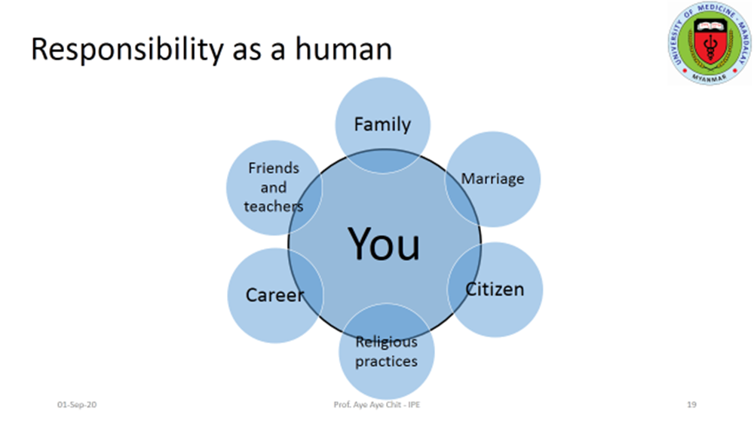
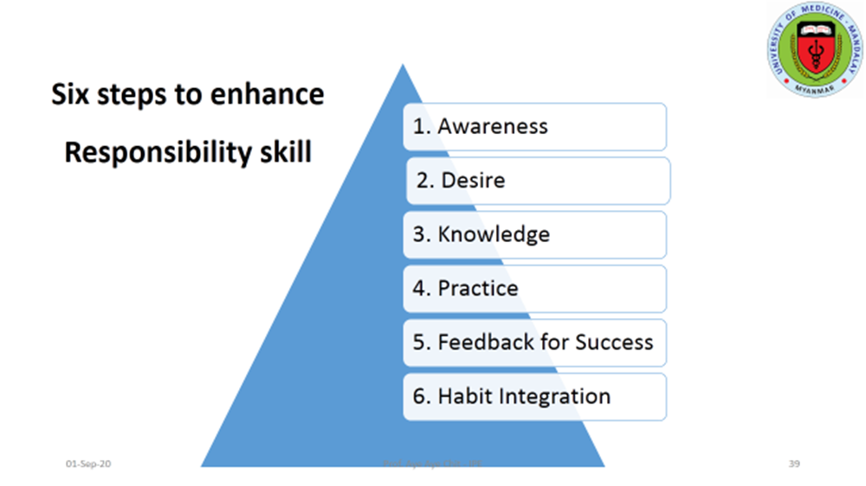
Take Home Message

Slide 35
The National Health Professional Education Foundation (NHPE) Thailand 2018
References
Thank you

